Slide 1
Section 4
IPv4, TCP, UDP, and Wireshark Analysis

Slide 2
IPv4 Overview
Each packet has a header (metadata) and data (payload).
IPv4 operates at OSI Layer 3 (Network Layer).
It handles logical addressing (source and destination IPs) and routing across networks.

Slide 3
IPv4 Header Fields
Field Name | Bits | Description / Purpose
Version | 4 | Identifies IP version (IPv4)
Header Length | 4 | Size of the IP header in 32-bit words
Type of Service (ToS) | 8 | Defines packet priority / QoS
Total Length | 16 | Entire packet size (header + data)
Identification | 16 | Unique ID for packet fragmentation
Flags | 3 | Control bits for fragmentation
Fragment Offset | 13 | Position of fragment in datagram
Time To Live (TTL) | 8 | Limits packet lifetime in network
Protocol | 8 | Next layer: TCP = 6, UDP = 17
Header Checksum | 16 | Error detection for the header
Source IP Address | 32 | Sender’s IP address
Destination IP Address | 32 | Receiver’s IP address

Slide 4
TCP Overview
Transmission Control Protocol (TCP)
Reliable and connection-oriented.
Uses acknowledgments and retransmissions.
Used by: HTTP, HTTPS, FTP, Email.

Slide 5
TCP 3-Way Handshake
The TCP 3-Way Handshake ensures reliable, synchronized communication between two devices before data transfer begins.
Step | Message | Purpose / Explanation
1 | SYN (Synchronize) | Client initiates the connection and sends a request to start communication.
2 | SYN-ACK (Synchronize + Acknowledge) | Server acknowledges the request and signals readiness to establish a connection.
3 | ACK (Acknowledge) | Client confirms the server’s response — the connection is now established.

Slide 6
TCP Header Fields
Field Name | Bits | Description / Purpose
Source Port | 16 | Identifies the sending application’s port number.
Destination Port | 16 | Identifies the receiving application’s port number.
Sequence Number | 32 | Indicates the position of the first byte of data in this segment.
Acknowledgment Number | 32 | Confirms receipt of data by acknowledging the next expected byte.
Data Offset (Header Length) | 4 | Specifies the size of the TCP header.
Flags (Control Bits) | 6 | Controls the connection (SYN, ACK, FIN, RST, PSH, URG).
Window Size | 16 | Defines the size of the receiver’s buffer for flow control.
Checksum | 16 | Used for error detection in the header and data.
Urgent Pointer | 16 | Indicates data that should be prioritized as urgent.
Options (Optional) | Variable | Used for features like window scaling or timestamps.

Slide 7
UDP Overview
User Datagram Protocol (UDP)
Fast, connectionless, unreliable.
No acknowledgments.
Used in DNS, VoIP, Streaming, Games.

Slide 8
UDP Header Fields
Field Name | Bits | Description / Purpose
Source Port | 16 | Identifies the sending application's port number (optional if not needed for reply).
Destination Port | 16 | Identifies the receiving application's port number.
Length | 16 | Specifies the total length of the UDP header and data (in bytes).
Checksum | 16 | Used for error detection of the header and data; optional in IPv4 but mandatory in IPv6.

Slide 9
TCP vs UDP Comparison
Feature | TCP (Transmission Control Protocol) | UDP (User Datagram Protocol)
Connection Type | Connection-oriented (establishes a session) | Connectionless (no session setup)
Reliability | Reliable – ensures delivery, retransmits lost packets | Unreliable – no delivery guarantee
Order of Data | Packets arrive in sequence | Packets may arrive out of order
Speed | Slower due to overhead and acknowledgments | Faster due to low overhead
Flow Control & Congestion | Supported (using windowing and ACKs) | Not supported
Header Size | 20 bytes (minimum) | 8 bytes
Error Checking | Checksum with error recovery | Checksum only (no recovery)
Use Cases | Web browsing, email, file transfer (HTTP, SMTP, FTP) | Streaming, VoIP, DNS, gaming

Slide 10
Port Numbers
Purpose: Ports identify specific applications or services using the network.
Format: Each port is represented by a 16-bit number (0–65,535).
Function: Helps distinguish multiple network connections on a single device.
Range | Type | Example / Usage
0 – 1023 | Well-known ports | Common services (e.g., HTTP – Port 80, HTTPS – Port 443)
1024 – 49151 | Registered ports | Applications registered by vendors (e.g., MySQL – Port 3306)
49152 – 65535 | Dynamic / Private ports | Temporary or client-side ports used during communication

Slide 11
Common TCP and UDP Ports
Service | Port | Protocol | Description
HTTP | 80 | TCP | Web traffic (unencrypted)
HTTPS | 443 | TCP | Secure web traffic (SSL/TLS)
FTP | 21 | TCP | File transfer
DNS | 53 | UDP / TCP | Domain name resolution
DHCP | 67 / 68 | UDP | Automatic IP address assignment
SMTP | 25 | TCP | Sending emails
POP3 | 110 | TCP | Retrieving emails
SSH | 22 | TCP | Secure remote access

Slide 12
What is Wireshark
Wireshark is a free, open-source network protocol analyzer.
It captures and displays network packets in real time.
Helps us visualize how data moves through the OSI model.
Used by students, engineers, and security analysts.
Download link: https://www.wireshark.org/download.html

Slide 13
Why Do We Use Wireshark?
Observe real network traffic live.
Understand IPv4, TCP, and UDP headers.
Filter packets by protocol: ip, tcp, udp.
Learn communication between devices using port numbers.
Bridge theory (OSI) and practice (real packets).

Slide 14
Wireshark Interface Overview
Menu & Toolbar: Located at the top — allows access to capture options, filters, and analysis tools.
Filter Bar:Used to apply display filters (e.g., tcp, udp, ip.addr == 192.168.1.2) to narrow down captured traffic.
Packet List Pane (Top Section):Displays a summary of each packet captured:
No., Time, Source, Destination, Protocol, Length, and Info
Each row = one packet
Packet Details Pane (Middle Section):Shows the selected packet’s details by layer:
Ethernet (Layer 2)
IPv4 (Layer 3)
TCP/UDP (Layer 4)
Application data (Layer 7)
Packet Bytes Pane (Bottom Section):Shows raw hexadecimal and ASCII data — the actual contents transmitted.
Status Bar (Bottom Line):Displays interface info, total packets, and live capture status.

Slide 15
Starting Your First Capture
Open Wireshark.
Select your active interface (Wi-Fi/Ethernet).
Click ▶ Start.
Generate traffic
Stop capture (■).
Observe packet headers.
Save and analyze results.
Each row = one packet (Source, Destination, Protocol, Length, Info).

Slide 16
Wireshark Packet Analysis
Identify Source/Destination IPs.
Check Ports, Protocol, TTL, Flags.
Compare TCP and UDP packets.

Slide 17
Packet Layers in Wireshark
Captured packet example:
Ethernet II → MAC source/destination.
IPv4 → Source/Destination IP, TTL, Protocol.
TCP/UDP → Ports, Flags, Sequence.
Application → HTTP/DNS/TLS, etc.
Each maps to OSI layers 2–7.

Slide 18
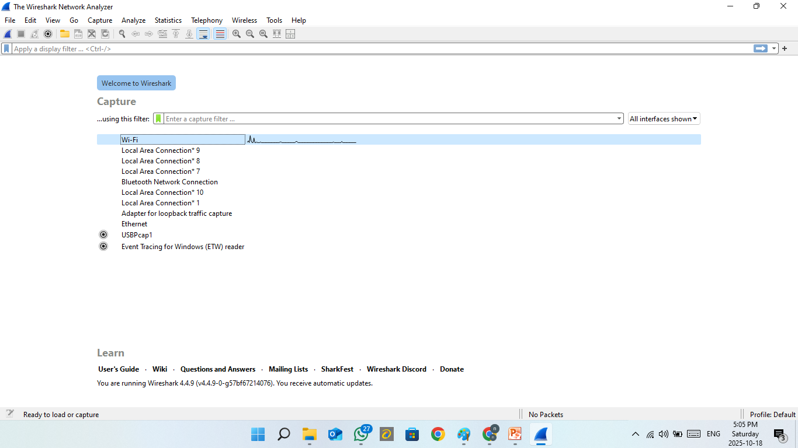
How to use

Slide 19
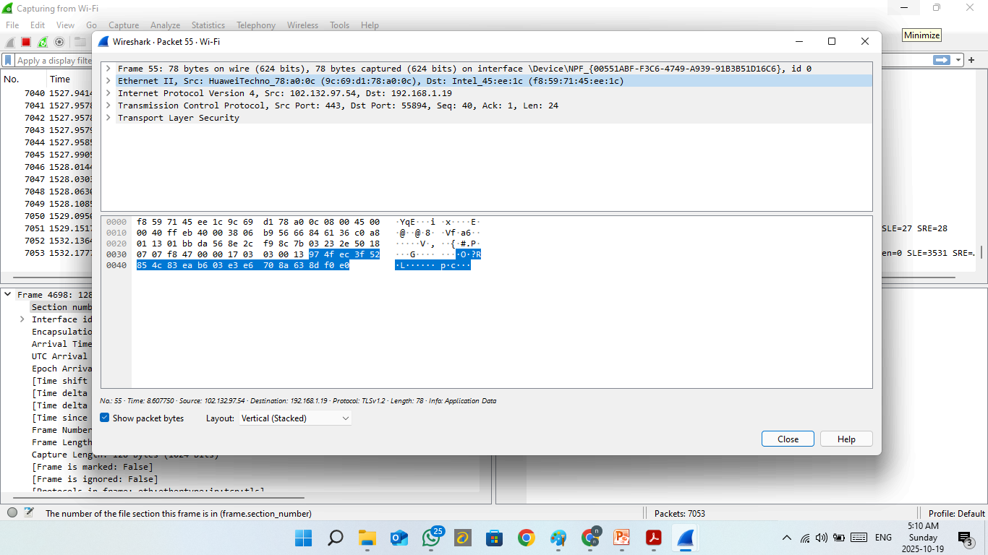

Slide 20
Layer | Protocol | Field | Value | Explanation
Layer 2 | Ethernet II | Destination MAC | f8:59:71:45:ee:1c | MAC address of your device (destination)
 |  | Source MAC | 9c:69:d1:78:a0:0c | MAC address of the router/server (Huawei device)
 |  | Type | 0x0800 | Indicates that the next layer is IPv4
Layer 3 | IPv4 | Version | 4 | Protocol version = IPv4
 |  | Header Length | 20 bytes | Size of the IP header
 |  | Total Length | 78 bytes | Total size of the entire packet
 |  | Protocol | 6 (TCP) | The next layer uses TCP
 |  | Source IP | 102.132.97.54 | IP address of the remote server
 |  | Destination IP | 192.168.1.19 | IP address of your local device
 |  | TTL (Time To Live) | 113 | Maximum hops before the packet is discarded
Layer 4 | TCP | Source Port | 443 | HTTPS port (server side)
 |  | Destination Port | 55894 | Temporary (ephemeral) client port on your device
 |  | Sequence Number | 40 | Position of the first byte in this TCP segment
 |  | Acknowledgment Number | 1 | Acknowledges receipt of previous data
 |  | Header Length | 20 bytes | TCP header size
 |  | Flags | ACK | Acknowledgment only — no new data sent
 |  | Window Size | 65535 | Flow control value (receiver buffer size)
Layer 7 | TLS (HTTPS) | Protocol Type | TLSv1.2 | Encrypted communication over HTTPS
 |  | Info | Application Data | Data is encrypted (TLS payload)
Overall Packet |  | Size | 78 bytes (624 bits) | Total packet length on the wire
 |  | Direction | From server to client | Data is coming from the Internet to your local device

Slide 21
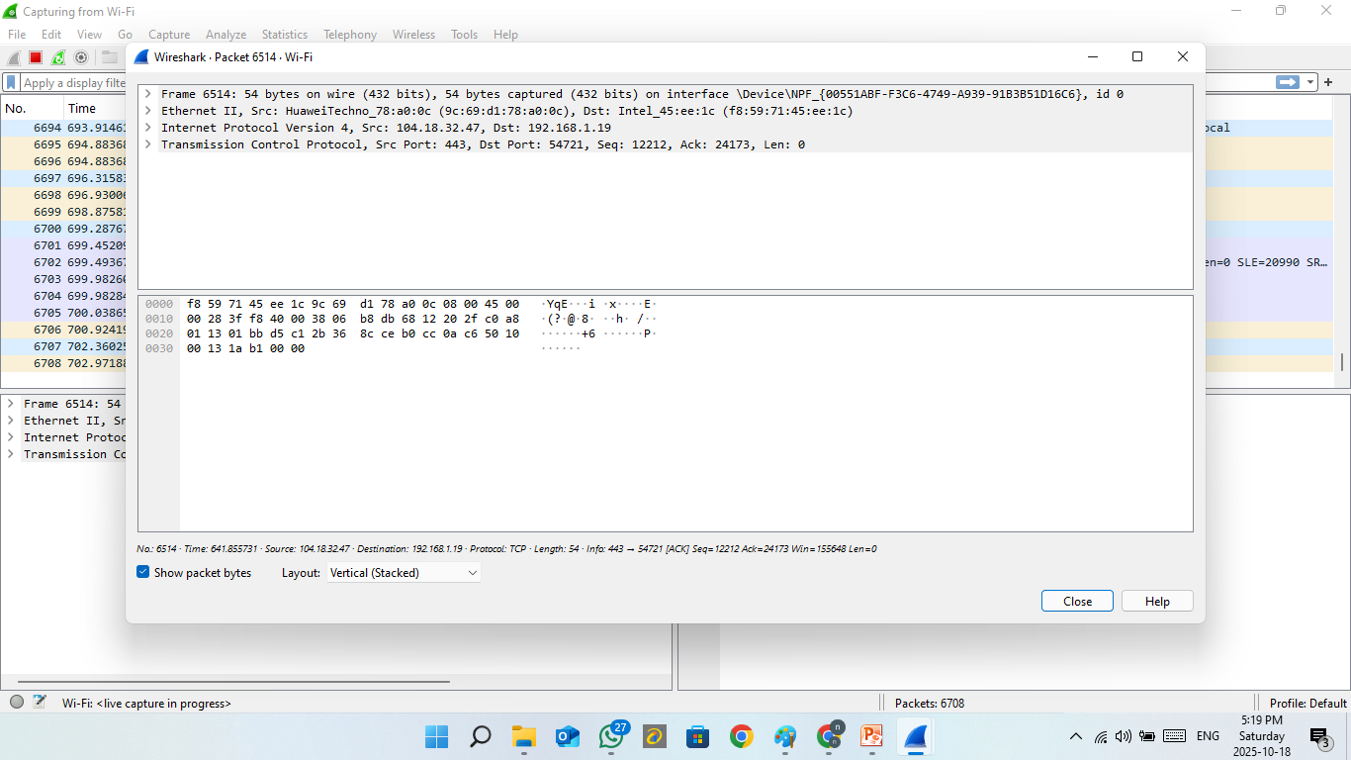

Slide 22
Layer | Protocol / Field | Details / Description
Frame | Size | 77 bytes on wire (616 bits); 77 bytes captured
 | Interface | Wi-Fi (\Device\NPF...)
Ethernet II | Destination MAC | 01:00:5e:7f:ff:fa (IPv4 multicast for 239.255.255.250)
 | Source MAC | a4:30:7a:65:8c:cc (SamsungElect_65:8c:cc)
 | EtherType | 0x0800 → IPv4
IPv4 | Version / IHL | v4, header 20 bytes
 | Total Length | 77 bytes
 | Source IP | 192.168.1.2
 | Destination IP | 239.255.255.250 (multicast)
 | Protocol | 17 → UDP
 | TTL | 1 (local-link only)
UDP | Source Port | 59307 (ephemeral)
 | Destination Port | 15600
 | Length | 37 bytes (8-byte header + 29-byte data)
 | Checksum | Valid
Application Data | Payload | ASCII shows BSDP/0.1=DEVICE … =0:SERVI CE=1 (vendor discovery/announcement)
Interpretation |  | Local multicast discovery packet sent by a Samsung device to the LAN; not routed to the internet (TTL=1).

Slide 23
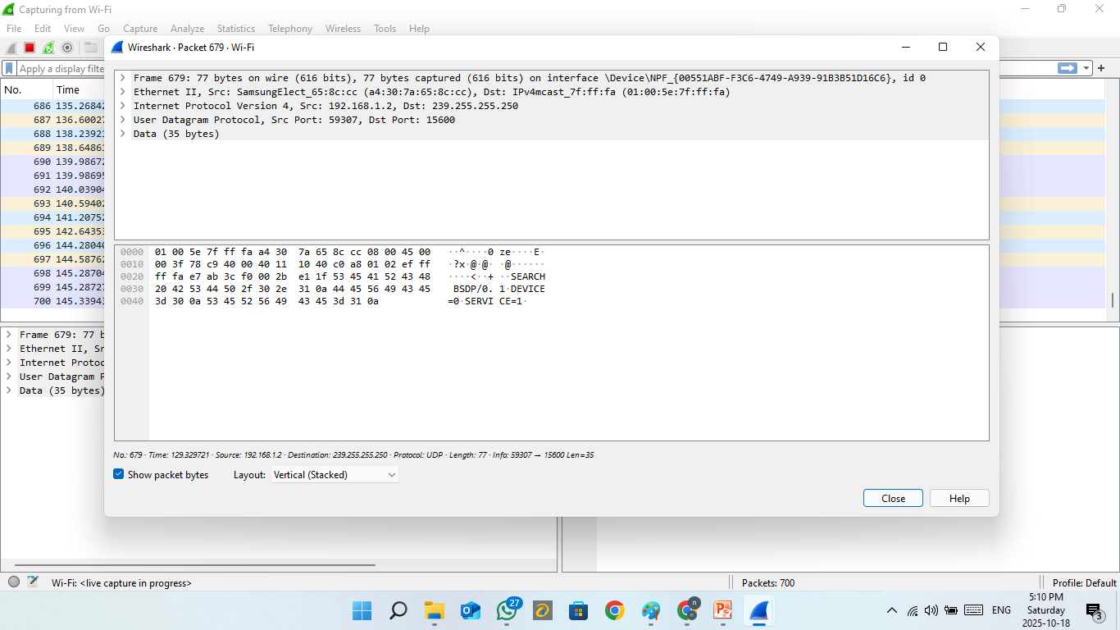
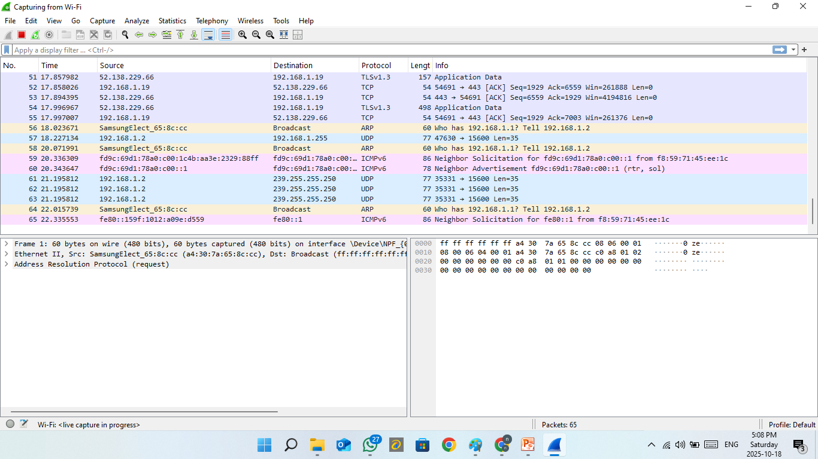

Slide 24
Layer | Protocol | Field | Value | Explanation
Layer 2 | Ethernet II | Destination MAC | 01:00:5e:7f:ff:fa | Multicast address (IPv4 multicast for 239.255.255.250)
 |  | Source MAC | 64:30:7a:65:8c:cc | MAC of your Samsung device (the sender)
 |  | Type | 0x0800 | Indicates the next protocol is IPv4
Layer 3 | IPv4 | Version | 4 | IPv4 packet
 |  | Header Length | 20 bytes | Standard IPv4 header size
 |  | Total Length | 77 bytes | Entire packet size (header + data)
 |  | Source IP | 192.168.1.2 | Local device (Samsung phone or PC)
 |  | Destination IP | 239.255.255.250 | Multicast address for SSDP (Simple Service Discovery Protocol)
 |  | Protocol | 17 (UDP) | Upper-layer protocol is UDP
 |  | TTL (Time To Live) | 1 | Packet meant to stay within local network (not routed)
Layer 4 | UDP | Source Port | 59307 | Random high port (client side)
 |  | Destination Port | 15600 | Service port (used by the receiving service)
 |  | Length | 35 bytes | Size of UDP data payload
Layer 7 | Data (Application Layer) | Payload | M-SEARCH * HTTP/1.1 and ST: SSDP:ALL (inside data) | This looks like SSDP/UPnP discovery traffic — used by smart devices to find others on the LAN.

Slide 25
Common Mistakes & Troubleshooting
• No packets: wrong interface or no permissions.
• Too many packets: add filters.
• Encrypted HTTPS: content not visible.
• Use Expert Info for warnings and retransmissions.
• Save captures: File → Save As (.pcapng).

Slide 26
Filtering Traffic
Display Filters (after capture):
• ip, tcp, udp, http, dns
• tcp.port == 443
• ip.addr == 192.168.1.19
Capture Filters (before capture):
• host 192.168.1.19
• port 53
• tcp and port 80
Use filters to focus analysis.

Slide 27
Summery
IPv4: Addressing and routing.
TCP: Reliable delivery.
UDP: Fast, simple delivery.
Ports: Identify services.
Wireshark: Observe everything in practice.

Slide 28
Homework
Objective: Apply IPv4, TCP, UDP, and Port concepts.
Install Wireshark.
Capture live packets.
Select 4 packets: IPv4, TCP, UDP, App layer.
Analyze each (IPs, Ports, Protocol, Fields).
Write report with screenshots.
Submit to classroom system.

